Slide 1
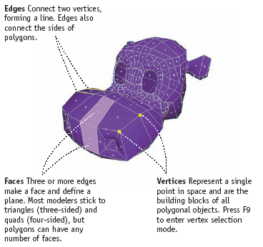
Polygons
Polygonal models are made up of edges, faces, and vertices

Slide 2
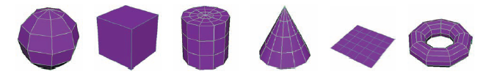
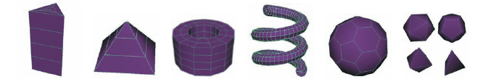
Polygon Primitives
Polygon primitives include:
sphere
cube
cylinder
cone
plane
torus
prism
pyramid
pipe
helix
soccer ball
platonic

Slide 3
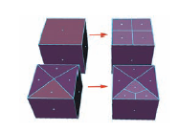
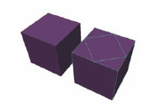
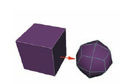
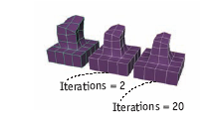
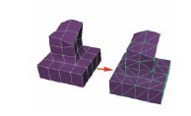
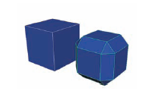
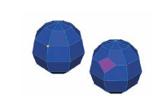
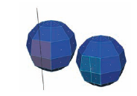
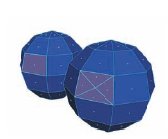
Modifying Polygonal Surfaces
Add Divisions
Split Polygon Tool
Smooth
Average Vertices
Triangulate
Bevel
Chamfer Vertex
Cut Faces
Poke Face

Slide 4
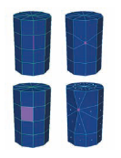
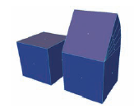
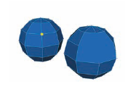
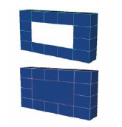

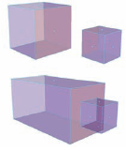
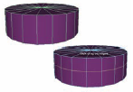

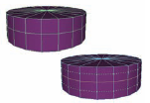
Modifying Polygonal Surfaces
Wedge Face
Merge
Delete Edge/Vertex
Fill Hole
Make Hole
Mirror Cut
Mirror Geometry
Insert Edge Loop Tool
Offset Edge Loop Tool

Slide 5
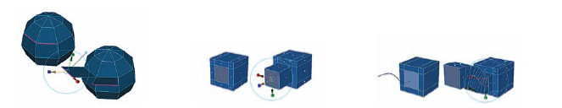
Extrusions
Extrude pulls a component outward to add detail to models
You can extrude a vertex, edge, or face
You can extrude along a curve

Slide 6
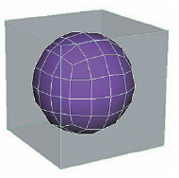
Subdiv Proxy
Simulates many of the same attributes of Subdivision Surfaces
Smoothes out a blocky polygon base model
Creases can be added to edges using the Crease Proxy Edge Tool

Slide 7
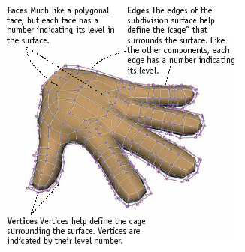
Subdivision Surfaces
Combines the ease of polygonal modeling with the smoothness of NURBS surfaces
Components include faces, edges, and vertices

Slide 8
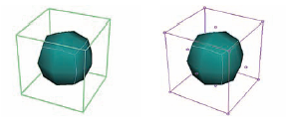
Subdivision Surfaces
2 Modes:
  Polygon mode: Lets you model and manipulate the base level with standard polygon tools
  Standard mode: Lets you navigate the hierarchy of the subdivision surface and add detail

Slide 9
Subdivision Surfaces
SubD’s contain Levels of detail; the higher the level, the more detail you can model
SubD’s can be creased to break the smoothness along an edge

